Slide 1




Module 3 – Mitigation Hierarchy
Training Modules for Applying the Mitigation Hierarchy:
Planning Policy and Projects for No Net Loss or a Net Gain of Biodiversity
Module 3
The mitigation hierarchy, including offsets and compensation, and goals such as Biodiversity Net Gain, No Net Loss.

Slide 2
Mitigation Hierarchy Module – Abstract
The mitigation hierarchy is one of the principal tools to enable governments and companies to reconcile development and biodiversity conservation goals.
This module explains the mitigation hierarchy, why it is useful and some of the key drivers for using it: law, project finance conditions, voluntary corporate commitments and the availability of practical tools for doing so.
It explains the first two steps in the mitigation hierarchy, including ‘avoidance’ (the most important step) and the second step: minimisation. It then covers restoration (the third step in the hierarchy) and the concept of ‘residual impacts’ (those left after avoidance, minimisation and restoration). It explains the last step: ‘biodiversity offsets’ or compensation. The module sets out three alternative end goals for applying the mitigation hierarchy: No Net Loss, Biodiversity Net Gain, and target-based compensation.
Finally, it explains the difference between offsets and compensation.

Slide 3
Mitigation Hierarchy Module - Contents
Contents | Slides
Introduction: The mitigation hierarchy and why follow it? Drivers and recent advances. | 4-6
Avoidance and minimisation | 7-16
Restoration and residual impacts | 17-21
Biodiversity offsets | 22-24
No Net Loss, Biodiversity Net Gain and target-based compensation | 25-32
Offsets versus compensation | 33-35
Take home messages | 36

Slide 4
The Mitigation Hierarchy
No Net Loss, NNL
Net Gain
+
Biodiversity
Impact
Compensation
Offset
No Net Loss
PI
PI
PI
PI
Comp
Offset
Offset
Residual
Impact
-
R
PI = Predicted Impact
Av = Avoidance
Min = Minimisation
R = Rehabilitation/Restoration
Comp = Compensation
Offset = Offset
Biodiversity
Impact
Min
Min
Av
Av
Av
BBOP, adapted from Rio Tinto & Govt of Australia

Slide 5



Why follow the mitigation hierarchy?
Biodiversity: CBD Aichi targets – by 2020:
  “At least halve and, where feasible, bring close to zero the rate of loss of natural habitats, including forests”
  17% of terrestrial and inland water areas and 10% of marine and coastal areas protected
  At least 15% of degraded ecosystems restored through conservation and restoration
Development - by 2050:
Population 33%
Food demand 100%
Mining 60%
Energy 80%
Carbon emissions ?? 50% ??
….all bringing impacts on biodiversity
How to reconcile these?
Follow the ‘Mitigation hierarchy’

Slide 6
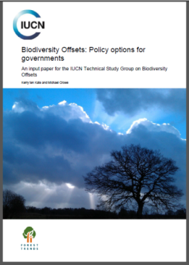
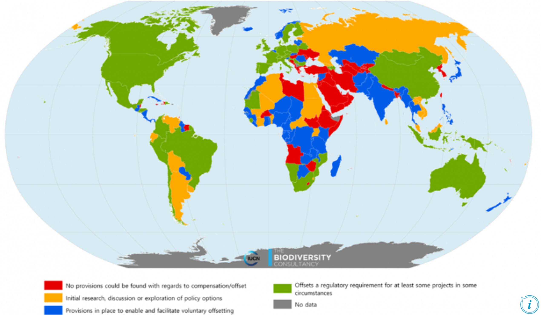





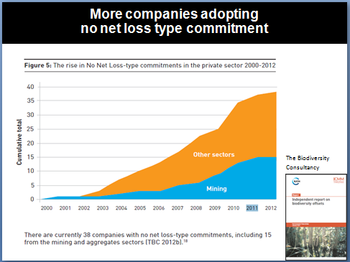
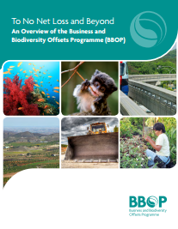




Drivers for better mitigation: recent advances
Laws
Loan conditions and Standards
    NNL natural habitat
    NG critical habitat
Corporate commitments, projects, and case studies
Methodologies
100 countries with law or policy on NNL/NG, biodiversity offsets or compensation
GIBOP – IUCN, TBC, DICE
40 companies with NNL or related commitments.
50 companies with Zero Net Deforestation commitments.
Regulated systems
Voluntary approaches
Notes:
Globally, the use of biodiversity offsets in the context of the mitigation hierarchy and to demonstrate NNL has been increasing rapidly over the past ten or so years. What are the main motivations for developers to follow this trend? There are essentially three key drivers:
1. Firstly, many governments already have legislation that requires and/or enables the use of biodiversity offsets or compensation.
- Laws requiring offsets or compensation are in place in 39 countries and an increasing number of governments (22) are investigating or introducing legislation specifically focused on offsets and the achievement of No Net Loss goals (which are variously termed NNL of biodiversity or NNL of native vegetation, net environmental gain, etc). The US with their wetland mitigation and species conservation banking schemes, Germany and Australia are well-known examples of established systems. Several states in Australia have their respective legislation and associated offset schemes (e.g. Biobanking in New South Wales, Bushbroker in Victoria – which are quite important to look to in terms of approaches, research and lessons learnt), while NZ, the EU, the UK and several other countries have been actively investigating this space, or are in the process of producing various forms of guidance.
- In addition, laws enabling compensation and offsets (e.g. EIA, planning law) are prevalent in the large majority of countries, for example as part of Environmental Impact Assessment regulations and planning law. This is the case in Peru and in South Africa for example.
2. A second and increasingly important driver is the set of loan conditions by Financial Institutions. Many financial institutions (eg large banks and export credit agencies) have environmental and social performance standards to which their clients need to adhere.
At the forefront here is the International Finance Corporation, IFC, which in 2012 published its revised Performance Standards. In addition, 83 financial institutions around the world (known as the members of the Equator Principles Association) also subscribe to these standards and apply them to their clients. The members of the Equator Principles Association include commercial and development banks around the world, operating in at least 36 countries. The revised PS (particularly PS6 which deals with the protection of biodiversity and the sustainable use of natural living resources) require that clients achieve NNL for impacts on what the IFC terms natural habitats (where feasible) and a net gain in so-called critical habitats.
3. Thirdly, more companies are undertaking offsets voluntarily because they can see business advantages in doing so. Linked with this is that there is more pressure from civil society, from the public, the companies’ employees, from conservation organisations and from the media for companies to ensure they follow good environmental and social practices.
But what exactly is the business case? Why would a company see a financial reason for investing in offsets if the law doesn’t require it and if their investors are not insisting? Businesses want to retain their ‘license to operate’ (which has legal and social aspects to it). Key factors here can be:
Access to land, natural resources, markets
Competitive advantage
Facilitates operations (permits etc.)
Stakeholder and employee relationships
Seat at the Policy table
There are numerous examples that demonstrate the financial materiality of companies’ impacts and dependence on biodiversity and ecosystem services.
For example, according to the Principles for Resonsible Investment: (See PRI ‘Universal Ownership – why environmental issues matter to institutional investors’ (2010)):
50% of companies’ earnings are at risk from environmental costs (equity portfolio weighted to MSCI-World Index.)
Environmental costs are becoming increasingly financially material.
Annual environmental costs from global human activity amounted to US$ 6.6 trillion in 2008, equivalent to 11% of GDP.
Cost of environmental damage caused by the world’s 3000 largest publicly listed companies in 2008: US$ 2.15 trn.
Under ‘business as usual’, global environmental costs to reach US$ 28.6 trillion, equivalent to 18% of GDP in 2050.
The infamous spill from BP’s Makondo well and its financial impacts on the company have been well documented. UNEP-FI’s CEO briefing lists:
US$90bn loss in market cap. US$20bn DH Oil Spill Trust.
35% share price fall between start and end of spill
Lower credit rating
50% higher insurance costs
There has also been an unquantified impact on license to operate.
Another driver for better mitigation is that we now have some good methodologies for putting the requirements of NNL and NG into practice. In regulated systems, governments have developed the rules and guidelines to use. Organisations such as BBOP, ICMM, IPIECA and IAIA have developed methodologies and publications to guide developers in following the mitigation hierarchy.

Slide 7
Mitigation hierarchy
Avoidance and minimisation

Slide 8
Avoidance and minimization
Avoidance measures are taken to anticipate and prevent adverse impacts on biodiversity before actions or decisions are taken that could lead to such impacts. They can take place at different scales and in both time and space:
Opportunity: is the project necessary?
Geography: can the project be built elsewhere?
Location: can the project be located in another site?
Minimization measures are taken to reduce the duration, intensity, significance and/or extent of impacts (including direct, indirect and cumulative impacts, as appropriate) that cannot be completely avoided, as far as is practically feasible. Minimization can be:
Spatial: can the project elements be arranged differently in space?
Temporal: can the project be phased differently?
Technical: can the project be designed differently (material, maintenance, operations…) ?
The effectiveness of mitigation measures depends on the sensitivity of the species and habitats involved

Slide 9
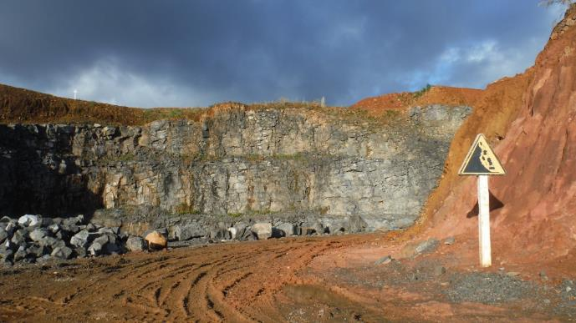
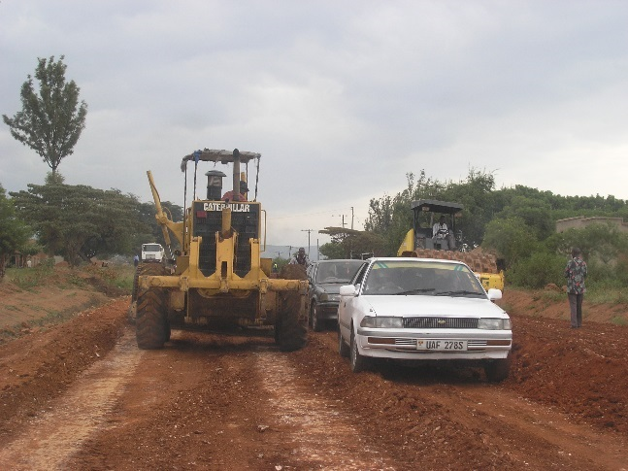
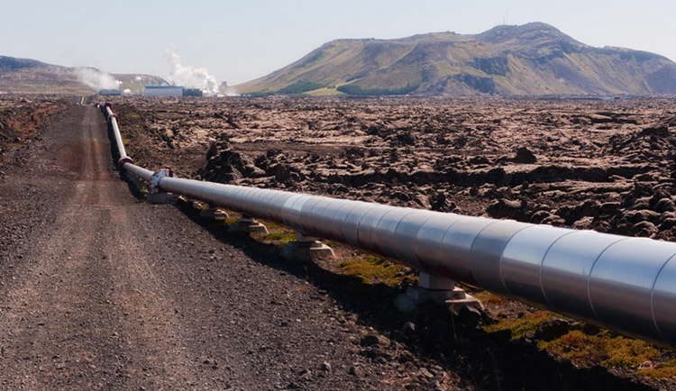
Most important is AVOIDANCE: better than remedy!
Avoidance is the most important step. Early planning of mitigation measures is key. It helps with:
Preventing harm from the outset, which is more effective than mending afterwards (e.g. through restoration, offsetting)
Early warning and good risk management
Identifying the most suitable and cost effective mitigation measures
Cost of avoidance and minimization often less than cost of offsets

Slide 10
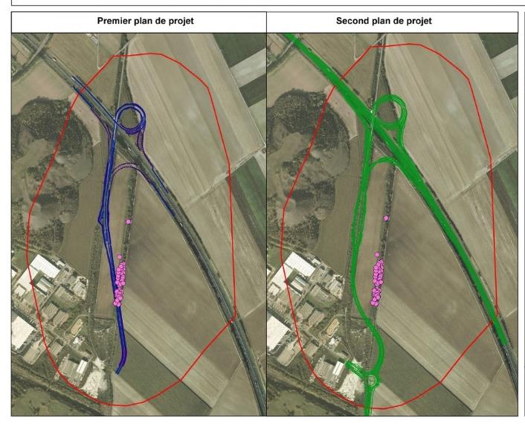
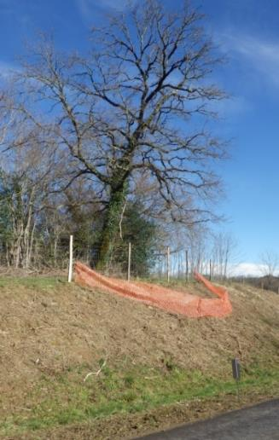
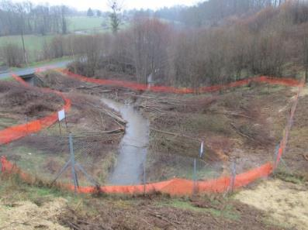
Avoiding impacts
Initial route
Modified route
Project location
Design options
Materials
Access options
Identification of set-asides
Does the EIA show how routing / design changes enabled some impacts to be avoided?
Sensitive species
Does the EIA include maps of set-asides?

Slide 11
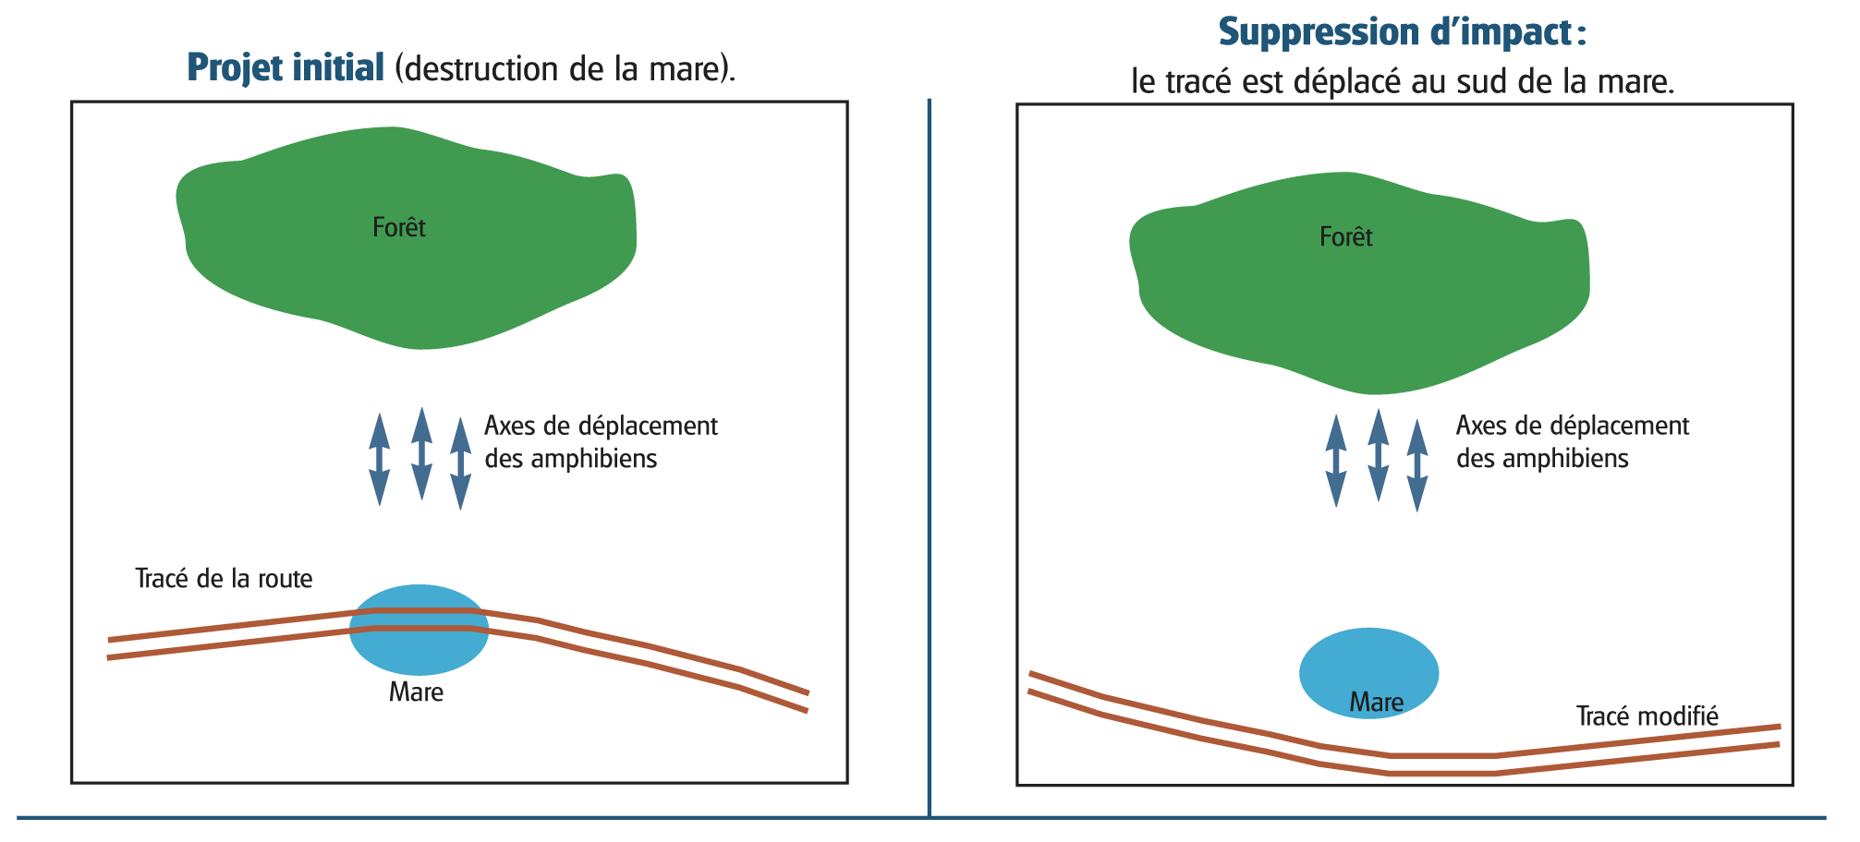
Avoiding impacts
Initial design: pond is destroyed
New design: pond is avoided
Forest patch
Forest patch
Amphibian migrations
Amphibian migrations
Road
Road
Pond

Slide 12
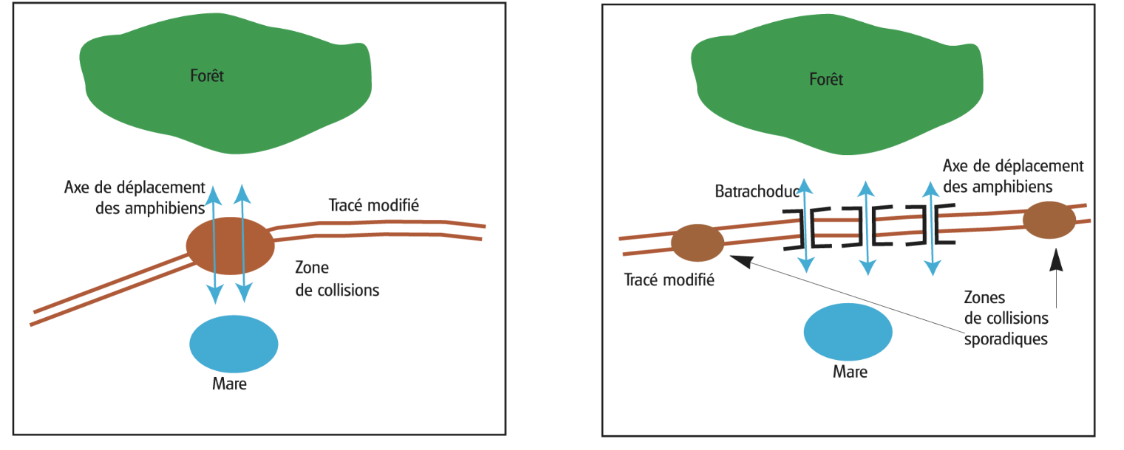
Minimizing impacts
Alternative design: pond isn’t destroyed but road blocks migration
Adding underpasses enable migration to continue
Forest patch
Forest patch
Road
Amphibian underpass
Collisions with migrating amphibians
Pond
Pond

Slide 13
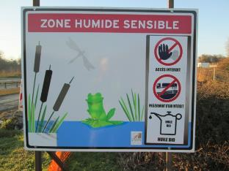
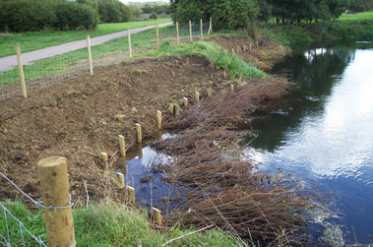
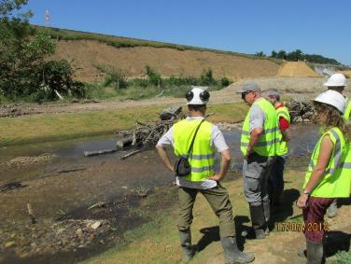
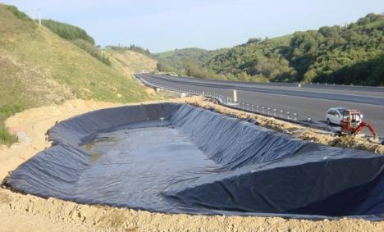
Minimizing impacts
There are countless steps that can minimize a project’s impacts on biodiversity and the environment more broadly, depending on the context. They include
Minimize construction and operations footprint
Construction planning (waste management, equipment movement, noise, lighting, etc.)
Timeline of operations (works during non-breeding season, during dry season etc.)
Pollution, nutrient load and erosion prevention and clean-up processes (water, air, dust…)
Stopping animals from entering construction site
Capture and relocation of animals away from construction site
Water passageways (continuity)
Fencing and under- or over-passageways
Prevention and control of invasive species
Construction of alternative habitat for small species

Slide 14
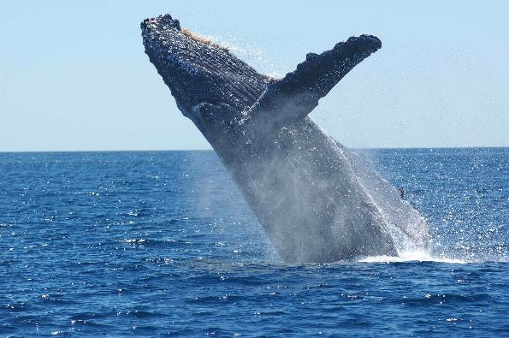
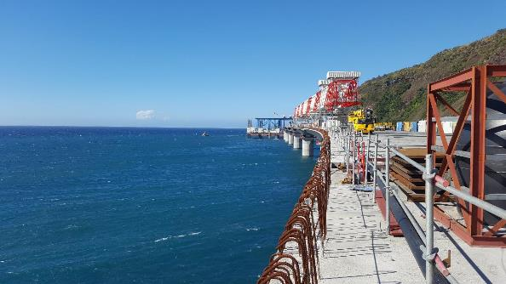
Minimization: noise
Aerial spotting of marine mammals
Bubble curtain to decrease sound
Continuous automated submarine sound recording
Submarine sound recording during works

Slide 15
Minimization
‘Measures taken to reduce the duration, intensity, significance and/or extent of impacts (including direct, indirect and cumulative impacts, as appropriate) that cannot be completely avoided, as far as is practically feasible.’
(CSBI)
Notes:
Putting up a fence
Manage access
Pollution control

Slide 16
Minimization: managing roads

Slide 17
Mitigation hierarchy
Restoration

Slide 18
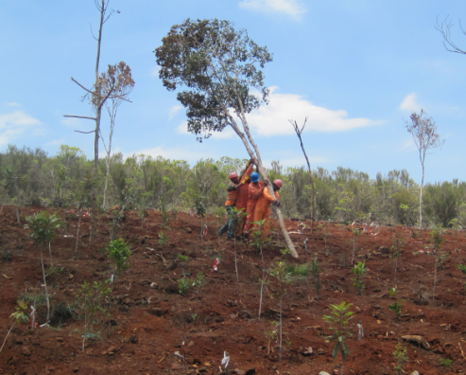
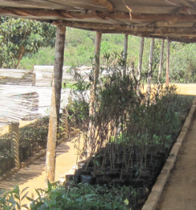
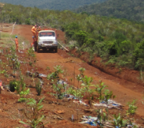
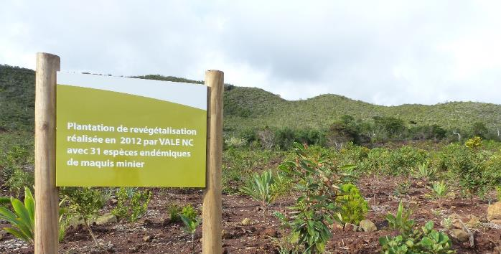
Decomissioning and restoration
Plant native species to restore pre-disturbance vegetation
Create novel ecosystem that provides benefits to local people
Does the project include decommissioning?
Does the EIA include post-construction and post-operations restoration?

Slide 19

Restoration of affected areas
Restoration should be based on evidence of ‘what works’ for a particular system or species (e.g. from field trials, previous research).
Common restoration activities include:
Collection and storage of topsoil from cleared areas and using this to restore any temporary roads, other project-impacted areas (short-term)
Preparation of project-disturbed areas for reseeding/ replanting with seedlings of the right species and during the right season
Invasive species control measures (e.g. where alien plant species have increased in project area)
Note: Restoration is also a way of undertaking activities for the final step in the mitigation hierarchy: offsetting / compensation
Monitoring is essential to track effectiveness of all mitigation measures, such as avoidance, minimization, restoration measures and offsets!

Slide 20
Restoration
⇒ See the module on Key Concepts, especially ‘Will restoration result in gains for biodiversity?’

Slide 21
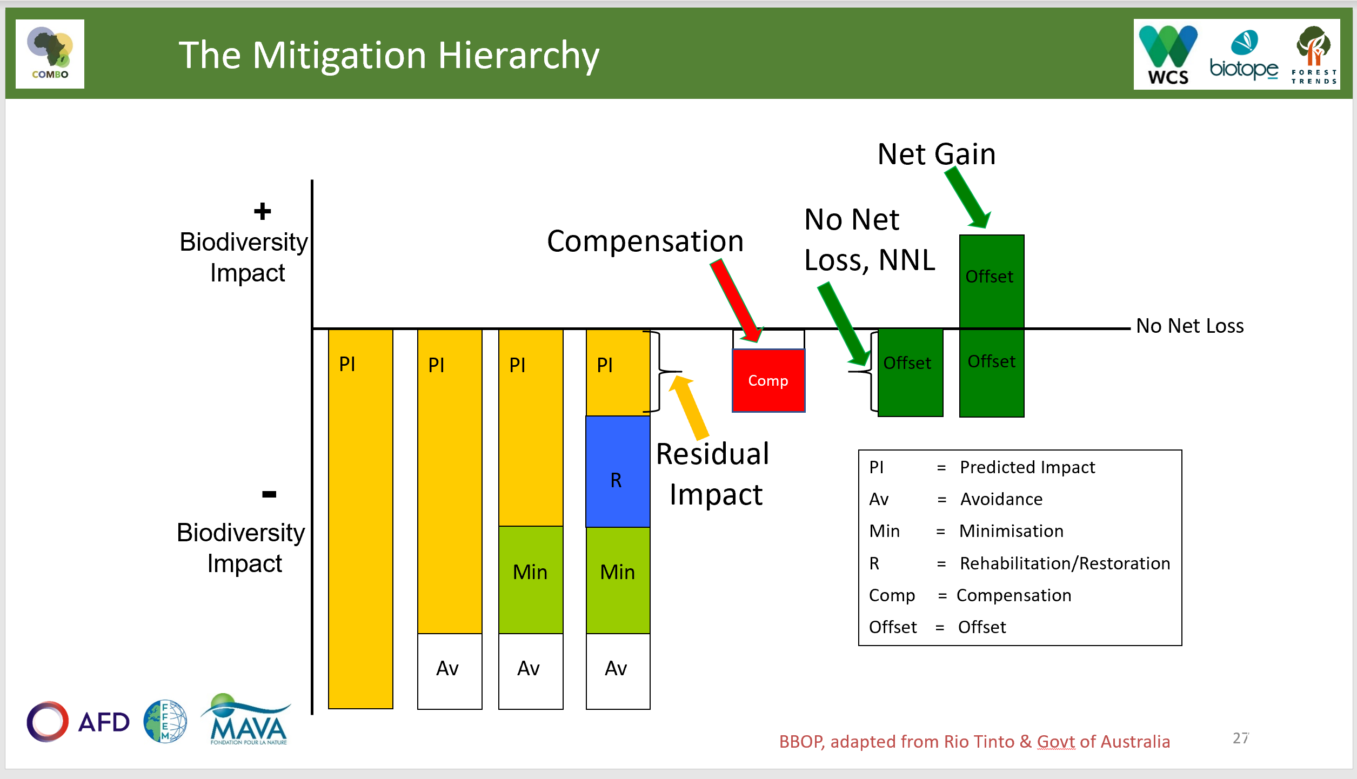
Residual Impacts
Residual impacts are the impacts that remain AFTER avoidance, minimisation, rehabilitation/restoration activities have been implemented. The objective of the offset or compensation is to address the residual impacts.
Avoid → Minimise → Rehabilitate/Restore → Offset Residual Impacts

Slide 22
Mitigation hierarchy
Biodiversity offsets

Slide 23
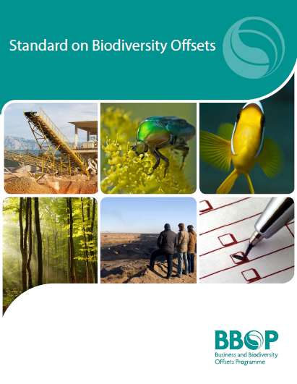
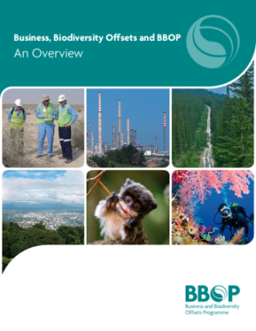
What are biodiversity offsets?
Biodiversity offsets are measurable conservation outcomes resulting from actions designed to compensate for significant residual adverse biodiversity impacts due to project development after appropriate avoidance, minimisation and restoration measures have been taken.
The goal of biodiversity offsets is to achieve no net loss or a net gain of biodiversity on the ground with respect to species composition, habitat structure, ecosystem function and people’s use and cultural values associated with biodiversity.
Source: BBOP. Principles 2009 and Standard 2012.
https://www.forest-trends.org/bbop/
Notes:
This definition was developed and agreed by all the members of the international Business and Biodiversity Offsets Programme: governments, companies, banks and conservation groups. It draws on definitions found in policy on biodiversity offsets in some thirty countries, as well as key elements of voluntary best practice. It’s worth emphasising are the following aspects:
Measurable = different from compensation in days gone by, which was more about a lump sum based on a company’s willingness to pay than measures designed specifically to be adequate to offset residual impacts.
Importance of the mitigation hierarchy and offsets only as the last step to address residual impacts and achieve NNL or a NG of biodiveristy.
On the ground = not just funding capacity building, awareness raising, research, but leading to ‘in situ’ conservation results
Species/habitat/ecosystem = all levels of biodiversity
People’s use and cultural values = no net loss, not just of threatened species. Also, to succeed with conservation in the long term, you need to address the underlying causes of loss of biodiversity in the landscape, which are often related to people’s uses of biodiversity.

Slide 24
All about offsets
Biodiversity offsets are a rich and controversial topic. This table lists some of the key issues associated with biodiversity offsets and which COMBO training modules and sources of information cover them.
⇒ See the following modules for more detail
Issue | Module and/or source of information on that issue
Need for biodiversity offsets and their role in society | Modules on Sustainable Development and Mitigation Hierarchy
Definition of biodiversity offsets and mitigation hierarchy | Module on Mitigation Hierarchy
Impact assessment, including alternatives analysis and establishing residual impacts | Module on Assessing Impacts
Calculating biodiversity offsets: exchange rules & metrics | Module on Metrics
Social aspects of offsets | Module on Social Context and Module on Stakeholders
Implementing biodiversity offsets | Module on Implementation Options
Monitoring and enforcement of biodiversity offsets | Module on Implementation Options
Planning biodiversity offsets as a company | Modules on Project and Business Roadmaps
Planning biodiversity offsets as a government | Module on Government Roadmap

Slide 25
Mitigation hierarchy
No Net Loss, Biodiversity Net Gain and Target-based compensation

Slide 26

Achieving “no net loss” of biodiversity through the mitigation hierarchy and biodiversity offsets
Biodiversity offsets are measurable conservation outcomes resulting from actions designed to compensate for significant residual adverse biodiversity impacts arising from project development after appropriate prevention and mitigation measures have been taken.
Goal is to achieve no net loss and preferably a net gain of biodiversity on the ground with respect to species composition, habitat structure, ecosystem function and people’s use and cultural values associated with biodiversity.
http://bbop.forest-trends.org

Slide 27
Biodiversity Net Gain and No Net Loss: Meaning
Simply stated, Biodiversity Net Gain (BNG),
sometimes described as Net Positive Impact (NPI), means
leaving biodiversity better off following development activity,
compared with a clear reference scenario.
No Net Loss is similar – with impacts at least balanced by the mitigation measures.
For governments, the goal may be set at a national, regional or local level.
For companies, the goal may be at a site, project or corporate level, or for part of the value chain.
For financial institutions, the focus could be their investment strategies, based on environment, social and governance (ESG) policy that refers to BNG.
In all cases, the goal must be defined relative to an appropriate reference scenario:
  ‘Net Gain of what and compared with what?’
Notes:
No Net Loss (NNL)
A goal for a development project, policy, plan or activity in which the impacts on biodiversity it causes are balanced or outweighed by measures taken to avoid and minimise the impacts, to undertake on-site restoration and finally to offset the residual impacts, so that no overall loss remains.
Biodiversity Net Gain (BNG)
A goal for a development project, policy, plan or activity in which the impacts on biodiversity it causes are outweighed by measures taken to avoid and minimise the impacts, to undertake on-site restoration and finally to offset the residual impacts, to the extent that the gain exceeds the loss.
NNL and BNG must be defined relative to an appropriate reference scenario (‘NNL or net gain of what compared with what?’). For governments, this goal may be set at a national, regional or local level. For companies, the goal may be at a site, project or corporate level, or for part of the value chain. For financial institutions, the focus could be their investment strategies, based on environment, social and governance (ESG) policy that refers to BNG/NNL.

Slide 28
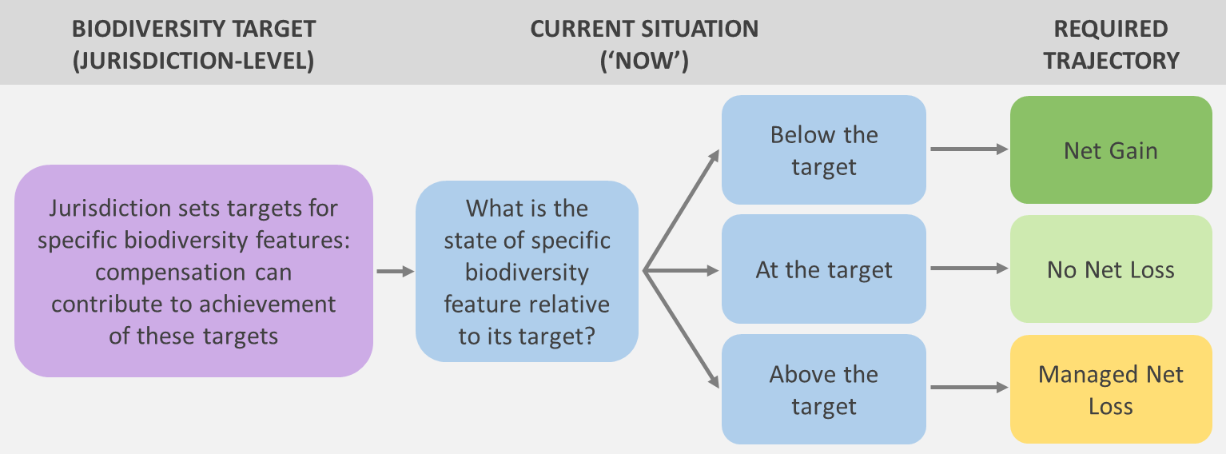

Example: When biodiversity targets are the reference
This diagram shows how mitigation can be aligned with jurisdictional biodiversity targets (when these provide the reference scenario). The required trajectory depends on whether a biodiversity feature is above, at, or below its jurisdictional target at the time this target is set (‘now’).
Source: Simmonds et al., in press. Conservation Letters.
See: Simmonds et al., in press. Moving from biodiversity offsets to a target-based approach for ecological compensation. Conservation Letters. This is an output from a SNAPP (Science for Nature and People Partnership) Project.
See also BBOP. 2018. Government Planning for Biodiversity Net Gain: a Roadmap.
Notes:
Good practice is to define the level for capping losses with reference to quantifiable jurisdiction-level targets that correspond with specific national and international biodiversity conservation goals. This is important to ensure that these targets and goals are not compromised. It is also good practice to describe the final outcome that is desired clearly —e.g. the amount of different ecosystems to be retained in good condition.

Slide 29
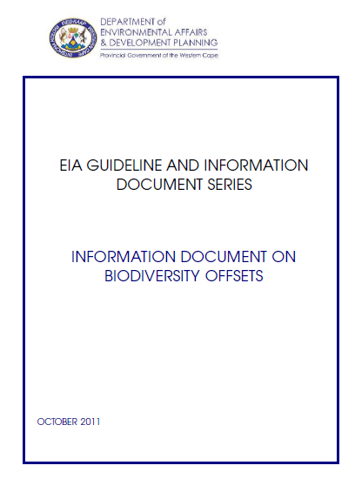
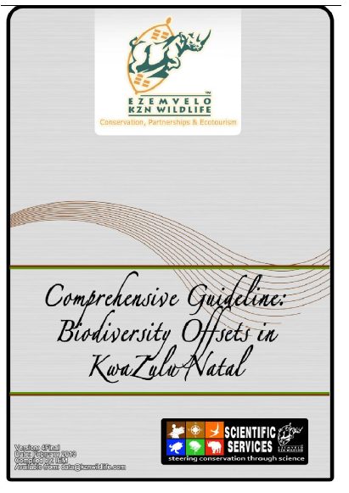
Example: Target-based compensation
Included in this framework for target-based compensatory conservation is a trajectory of ‘Managed Retention’ or ‘Managed Net Loss’.
Source: Simmonds et al., in press. Conservation Letters.
This approach applies only in certain circumstances and is a minimum standard. It allows for net biodiversity losses to occur, provided that the affected biodiversity feature is above the jurisdictional target.
Net biodiversity losses resulting from development and associated mitigation (including compensation) are capped at a defined minimum level - the target.
South Africa has pioneered this approach based on science- and outcomes-based biodiversity targets (e.g. for terrestrial ecosystems)
Provincial guidelines in South Africa: Western Cape guidelines (DEA&DP, 2015) &
Concise & Comprehensive Guideline: Biodiversity Offsets in KwaZulu-Natal: EKZN Wildlife (2013)
Notes:
Good practice is to define the level for capping losses with reference to quantifiable jurisdiction-level targets that correspond with specific national and international biodiversity conservation goals. This is important to ensure that these targets and goals are not compromised. It is also good practice to describe the final outcome that is desired clearly —e.g. the amount of different ecosystems to be retained in good condition.

Slide 30
No Net Loss and Biodiversity Net Gain
⇒ See the module on the No Net Loss and Biodiversity Net Gain

Slide 31
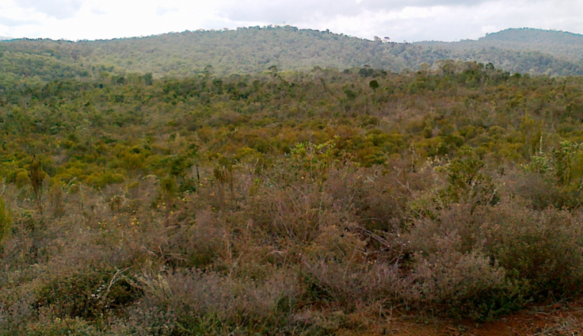
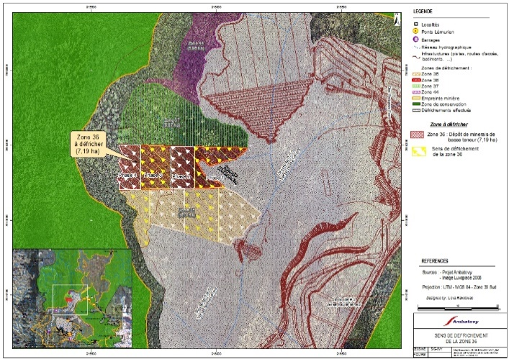
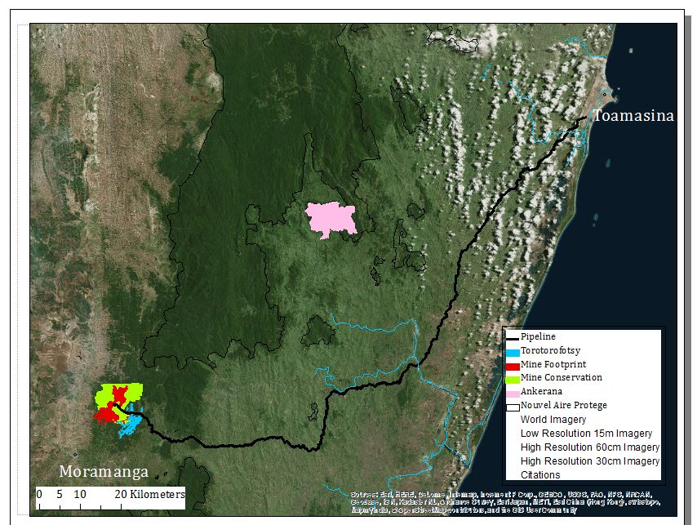
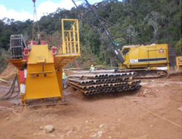
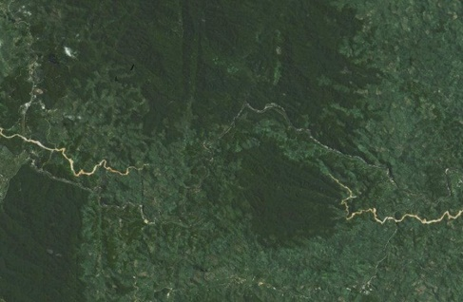

Examples of mitigation measures
Avoidance:
E.g. set-aside at mine site.
Avoidance:
E.g. Pipeline tunnels under forest.
Minimisation:
E.g. Paced directional clearing.
Avoidance:
E.g. Rerouting pipeline around specific forest patches.
Notes:
[TRAINERS – Please note: use animation to highlight each example of avoidance to be coordinated as you click through and present the information below.]
This slide of the Ambatovy Project shows the remaining forest in the region (green areas) and the location of the mine (red) footprint – where forest was cleared for the mine, as well the pipeline that runs to the coast at Toamasina (black line) where the processing plant is located.
Some of the many different actions being undertaken as part of the Mitigation Hierarchy, to avoid, minimise, restore and only as a last step offset the residual impacts on biodiversity, are shown. At the mine site, a mitigation programme that involves all of these steps is in place.
Recognising avoidance as the first and most important step in the MH, the developer has taken various stringent measures to prevent harm. It has voluntarily set aside an area which it had permission to mine. (This represents quite an economic sacrifice, but is really important to ensure that no biodiversity found only on the mine site is lost.) The set-aside area will be actively protected for permanent conservation.
To reduce the loss of biodiversity on the surface, the company has also tunnelled through mountains to bury part of the pipeline and avoid important blocks of forest, and chosen a route for the rest that’s already deforested. Compare that with business as usual: Most companies would have mined the entire area and picked the cheapest and most direct overground route for the pipeline, with a much bigger impact on biodiversity
[Additional Notes:
The following activities are part of the mitigation programme at the mine (but there are many more!):
No forest clearing above part of ore body (avoidance and set-aside)
Securing this forest area for long-term protection (offsetting)
Conservation management, monitoring
Alternative fuel wood sources for local communities to reduce pressure on forest
Day to day mine and biodiversity management to avoid and minimise impacts on surrounding biodiverstiy (there is a range of management plans for this)]

Slide 32
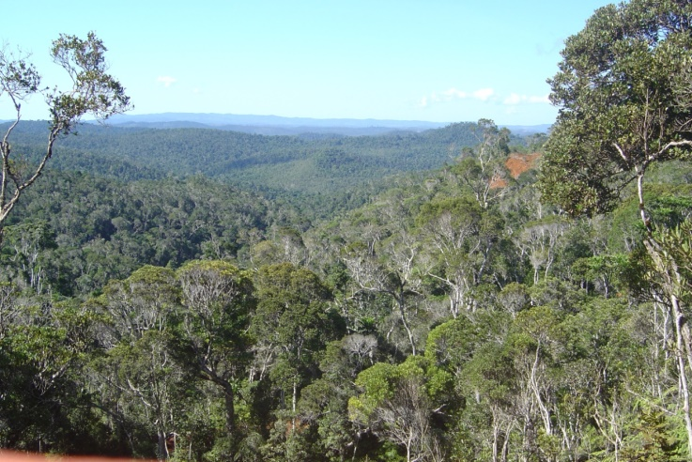
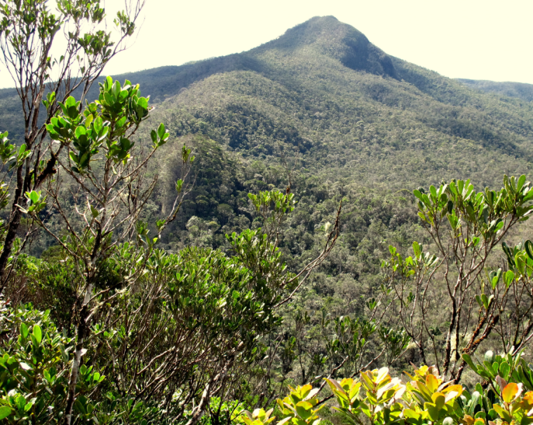
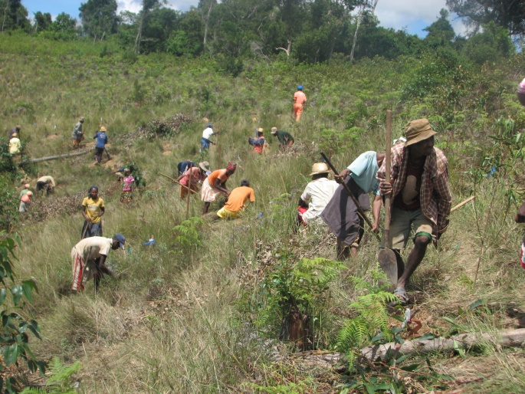
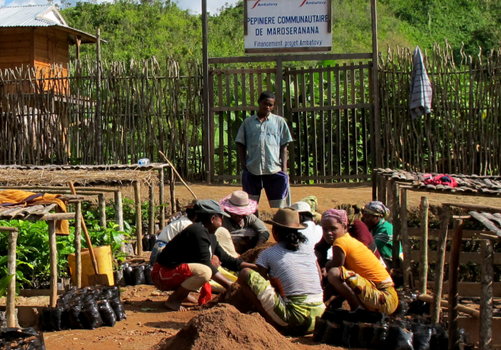
Offset: Conserving threatened forest around the mine
Offset: Protecting threatened Ankerana Forest
Offset:
Protecting and managing other priority areas which offer conservation jobs for local communities
Restoration:
On and around mine site and pipeline
Notes:
[TRAINERS – Please note: use animation to highlight each part of the offset to be coordinated as you click through and present the information below.]
To achieve its commitment of NNL and balance out its impacts, the company is also offsetting the residual impacts of the mine that remain after avoidance, minimisation and restoration. It has measured the residual losses expected on the different types of forest and freshwater habitats it is affecting and on over 600 species. Offsetting involves putting in place a suite of conservation activities in various locations at and around the mine site and further afield, such as at Ankerana, that are home to similar biodiversity and that are conservation priorities in great need of protection. This involves jobs in conservation for local communities and collaboration with conservation organisations and the government of Madagascar.
With key partners, the company is putting in place legal and financial arrangements to ensure the long-term protection of the offset sites and that money is available over decades to pay for the conservation and monitoring activities. It is measuring the conservation benefits of these activities to check they really balance the residual losses caused by the project. Without the long term protection through the offset, the forests at the offset sites would almost certainly have been lost to slash and burn agriculture and other impacts.
Most companies wouldn’t do any offsetting. They might take a few steps to try and reduce the project’s impacts, but go no further, leaving significant residual losses. Other developers might pay some compensation, but they wouldn’t use baseline studies and calculations to work out the kind of conservation activities needed to balance out and be commensurate with the damage.
What is important when considering this large spread of mitigation activities is that Ambatovy is a very large and complex mining project – it is a more than 7.2 Billion Dollar project and as such its impacts on biodiversity in a country like Madagascar (a biodiveristy hotspot of note) are undoubtedly significant and require significant efforts and measures to limit these impacts.

Slide 33
Mitigation hierarchy
Offsets vs Compensation

Slide 34


Offset vs. Compensation
Biodiversity offset:
Designed to achieve ‘no net loss’ or ‘net gain’
Compensatory conservation, e.g.:
Not planned to achieve no net loss
Doesn’t quantify loss/gain
Not established for long term implementation
Impossible to offset the impacts – e.g. impacts too severe or pre-impact data lacking
Financial payment, not biodiversity result
Notes:
Here we come to a key issue: In French, for example, there is just the one term: ‘compensation’. In English, however, there are two: ‘compensation’, which is quite broad, and ‘offset’ which is quite specific.
Compensation is a very flexible term that can mean a number of different things. Dictionary definitions often refer to something, typically money, awarded to an individual as recompense for loss, injury, or suffering. This has the connotation of damages or some kind of award to victims. Occasionally, compensation is defined more in terms of ‘making good’ specific damage, in which case it become closer to the definition of ‘offset’ above (except that it lacks the specific requirement for achieving ‘no net loss’).
A biodiversity offset, however, is something quite narrow and particular: measures specifically designed to achieve no net loss or a net gain.
Typical situations in which the outcome is compensation but not an offset include:
Where the compensation activities were not planned to with the aim of achieving no net loss
Where the compensation measures were defined without quantifying the loss caused by the project and the gain caused by the offset
Where the compensation measures were not established for long term implementation –for instance, there are no legal and financial arrangements in place to secure the outcomes for the long term
Where it would in fact be impossible to offset the impacts, for instance where they are too severe (making a species extinct is one extreme example) or where we just don’t have the data on what biodiversity was present before the impacts took place.
Where the outcome is defined in terms of a payment, but nothing is specified in terms of the result expected for biodiversity.

Slide 35
Offset vs. Compensation
Compensation
Offset
No compensation
Some investment in conservation but not quantified to balance the impacts
Some investment in conservation, aim to address footprint, but only based on some values/impacts
NNL
(No net loss)
Net gain
Would satisfy ‘No Net Loss’ requirements and Standards, e.g. IFC Performance Standard 6 and the BBOP Standard on Biodiversity Offsets
Notes:
The difference between the overarching concept of compensation and the more specific subset of ‘offsets’ is illustrated on this slide. It shows a spectrum.
On the left hand side, you see what is often the status quo: projects are allowed to proceed with no compensation.
At the other end of the scale, on the right hand side, we have a net positive outcome or net gain for biodiversity.
In between, we have marked some of the more common qualities of outcome in between.
Compensation actions thus cover a broad range of approaches, which include but are not necessarily offsets.
For instance:
Cases where there is some investment in conservation but it is not quantified so as to balance the impacts.
Further along, there are cases where there is some investment in conservation which is intended to address the footprint, but it only takes care of a subset of the biodiversity components affected and leaves other uncompensated.
Compensation (but not ‘offsets’) may take place under the following circumstances. E.g.
If a project is not planned to achieve NNL / NG
Doesn’t quantify loss/gain
Not established for long term implementation
When impossible to offset the impacts – for instance, the impacts are too severe for NNL, or pre-impact data is lacking
There is a financial transfer recognizing an ecological debt but with no defined conservation actions on the ground attached to it.
Then we come to the kind of compensation that is designed and implemented to achieve no net loss: that’s the point at which our compensation becomes a biodiversity offset.
And indeed one can go further and undertake enough compensation to demonstrate a net gain in biodiversity.
These last two levels of outcome, ‘no net loss’ and a ‘net gain’ are what are intended by relevant policy measures, and required by the standards we will introduce to you such as the IFC’s Performance Standard 6 and the BBOP Standard on Biodiversity Offsets.

Slide 36
Mitigation Hierarchy Module – Take home messages
Following the mitigation hierarchy can help governments and companies to reconcile development and biodiversity conservation goals.
The first and most important step is avoidance, after which many measures can be taken to reduce and lessen impacts (minimisation). Following the impacts, the affected areas should be restored.
Despite best efforts with avoidance, minimisation and restoration, many projects have ‘residual impacts’, which should be addressed through biodiversity offsets, or failing that, through compensation.
Laws in around 100 countries, project finance conditions and voluntary corporate commitments are driving the use by developers and policy-makers of the mitigation hierarchy. So is the availability of practical tools.
It is important for policy and corporate commitments to be clear on the desired outcome from applying the mitigation hierarchy. The best outcome is ‘Biodiversity Net Gain’. ‘No Net Loss’ is another possible goal. An alternative approach is target-based compensation. (All of these are explained in more detail in later modules.)

